Slide 1
HOW WESTSIDE LUMBER CO INSPIRED ME TO CREATE MY PERSONAL LOGGING MODEL RR
By: Frank Markovich – MMR 514
Email to contact me: frank@frankmarkovich.com

Slide 2
What will be covered in this clinic.
Introduction
West Side Lumber prototype – parts that inspired me.
Other similar Railroads that added to my inspiration.
What I took from each and then modeled.
Why I approached building a layout in this manner.
Photos of the prototype that inspired me.
Photos of my models and layout that show the inspiration.

Slide 3
About me
Building models since I was 6 years old. Over 60 years.
Started with military and auto – plastic kits.
Then the balsa covered airplanes – couldn’t fly them.
Trains by the time I was 20.
Similar progression – see slide further on.
MMR 514 –
Home layout, Twain Harte and Sonora Pass RR.
Building a layout for the Museum in Sacramento with Mike Blumensaadt. This should be installed before the convention
Have built 3 small layouts in the last 6 years for PCR with Mike Blumensaadt.
Retired from electrical engineering and teaching music at a community college.
Married (Susie – great wife), 3 children and 9 grand children.
Currently director for the Coast Division of the PCR and Vice President elect for the PCR.

Slide 4
Inspiration -
My On3 Twain Harte and Sonora Pass Railroad layout is set in the late 1940’s to late 1950’s. By doing this I can model more freely then by having an exact date.
It is set in the Sierras - near the quaint town of Twain Harte, California. This is a fictional narrow gauge logging line running from Sonora through Twain Harte, eastwards. My layout was inspired by several logging lines in the Sierra’s but mainly, the West Side Lum­ber Co., also included is the Pickering Lumber Com­pany.
Since my wife, Susie, and I have a cabin in Twain Harte - I have first-hand knowledge of what the layout's trees and scenery should look like.
All of the ground cover (dirt) is from the West Side town of Tuolumne.
This is part of the inspiration along with the scenery and even the color of the earth in this area.

Slide 5
What I really love about logging and West Side Lumber
From the very start of doing modeling, I was drawn to the unusual and funky part of railroading.
By modeling a logging line I have the opportunity to model some of the rolling stock that I like the most: snowplows, small cabooses, funky water cars, etc. Will show some of these going forward.
I also like small steam engines, particularly geared engines and other small steam engines.
I really like old wooden and stone buildings.
The ”Motherload” is ideal to me – goes from hills and Oaks to mountains and large pine, cedar and fur trees. As a side note, I also really like modeling trees.
A brief story: A number of years ago I attended a PCR convention in Santa Rosa, and PSC had a small shay loco running back and forth on a 0n3 piece of roadbed. It went very slow – so slow I could count the ties as it passed by. This led me to change from Hon3 to On3.

Slide 6
When I started model railroading I didn’t have a direction.
My first locomotives were all over the place, Mantua General, a Pennsylivia K5,AHM engines, etc. Plastic and Die cast engines, First buildings were plastic until I discovered Campbell etc. I went for steam but I didn’t have even an idea of what I would model. I bought a variety of equipment – none of which went together. First brass was a Pennsy K5. Liked how it looked but not practical for me.
Then I made a number of trips to the foothills and visited West Side Lumber (at that time it was West Side and Cherry Valley).
I found what I was looking for.
But now how to model?
Thought about modeling just the West Side – while that was interesting, I also liked some other logging roads and I didn’t want to model a single year or date.
I wanted to model some other structures than just what West Side had – I needed to be more open to some creative bending of history and the facts.
I started by doing a write up on what I would do – on the next couple of slides.

Slide 9
Twain Harte and Sonora Pass RR Was Born
The solution was to model much of the West Side Lumber but to image that it was bought out by my fixational RR and changes made.
Kept much of West Side but then added to it.
At first it was going to be in HOn3. In fact, started building it in HOn3 in our first home in Daly City, Ca. But I couldn’t get the small geared locos to run the way I wanted them to. Previous bullet on On3.
To digress, at the same time both my wife and I were working down the peninsula and we decided to move – to Belmont. This was 1984.
Now was the time to start the layout.

Slide 10
First steps.
I started planning the layout in 1984 when Susie and I moved to Belmont, Cali­fornia. But before building the layout, I needed a room. This was accomplished by digging out over 40 square yards of rock and dirt under our home, and putting in walls and a concrete floor. I hired a contractor to do that. Had engineering drawing done and got a building permit.
Actual work on the layout started in 1989, and proceeded for a few years before I took a break from modeling to raise our family. I picked up work on the layout again in 2007.

Slide 11
Following are some slides of West Side – the prototype
I used these and a number of books for references along with a number of trips to West Side – at this time Glen Bell owned it and it was West Side and Cherry Valley – a tourist RR.
We also purchased a cabin in Twain Harte – about 10 miles from West Side and in another direction about 7 miles from Pickering Lumber, and 12 miles from the Sierra RR – and in Twain Harte the Pickering main line ran about ½ a mile from our cabin. My daughter bought a house in Sonora – the Sierra runs right behind her house and Railtown is less than a mile away.

Slide 12
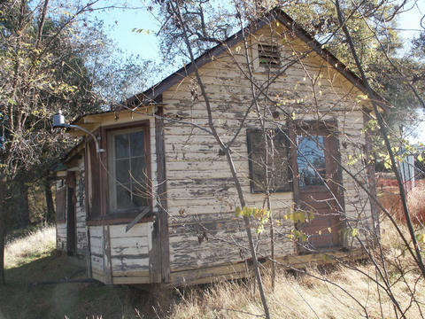
Notice more weather effects towards bottom of building.
Peeling paint. This is the sort of structure I like to model.

Slide 13
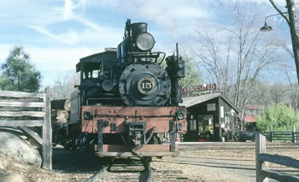
My favorite West Side Locomotive – now running on the Yosemite Mountain RR..

Slide 14
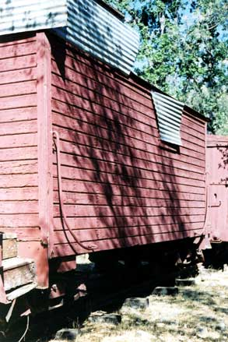
Rotting wood on stair – rough wood on the end. Shades on the wood – paint missing in spots. Fun to model.

Slide 15
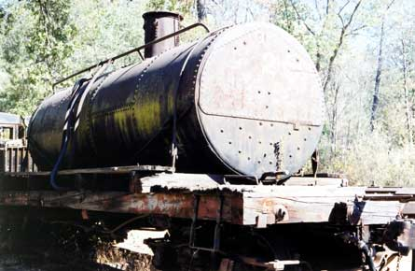
Funky tank car on West Side. Later will show model I built that this was inspiration for.

Slide 16
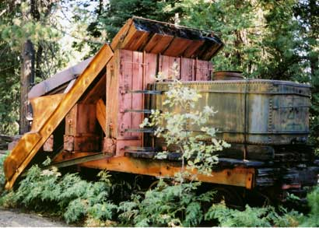
Look at the end of beams on the plow – black color with grain.
Paint missing on the rest of the wood. Stains everywhere. I have built a
number of snowplows. Both in Hon3 and On3 – Photos later of some of these.

Slide 17
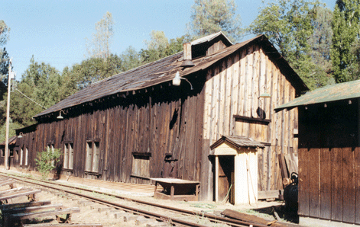
Look at the knots on the ends of this building. Also the foreground building the weathering towards the bottom.

Slide 18
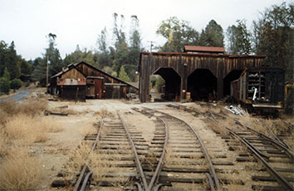
Look at the color change from the top of the building to the bottom.

Slide 19
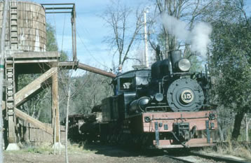
Water tank discoloration. You can get that with a white wash or even use bleach and a strong light source.

Slide 20
Now some photos of my layout and models

Slide 21
My layout in a 22’ by 16’ room.

Slide 26
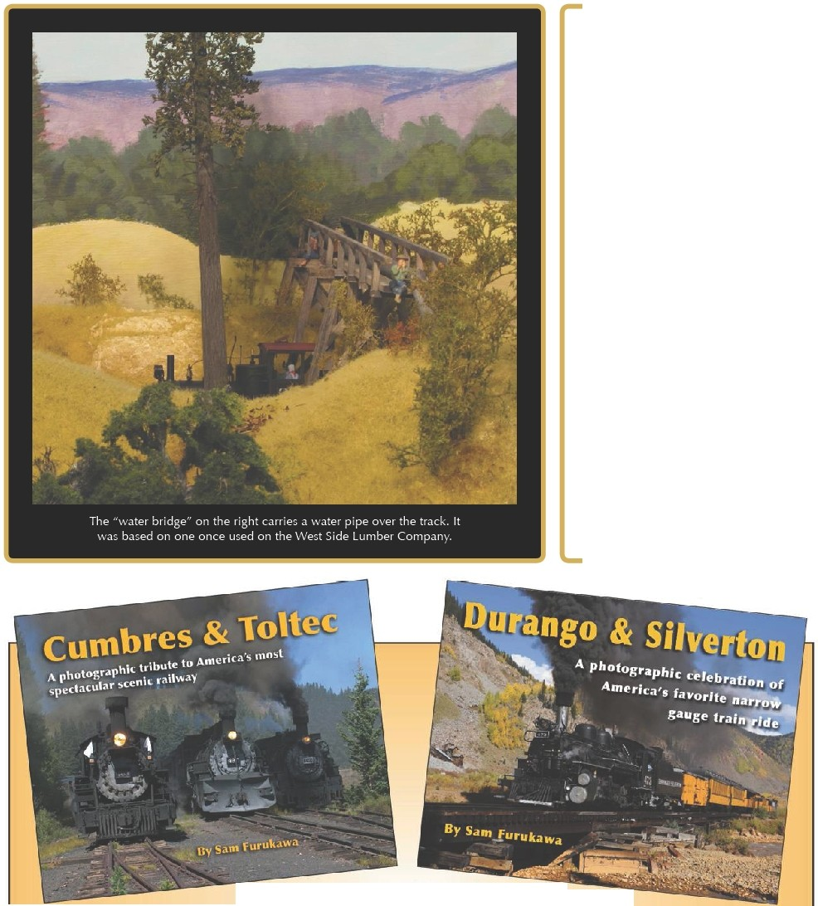

Slide 27
What I really like to model
Cabooses – small ones in particular.
Non-Revenue – Water Cars, Tool Cars, Snowplows etc.
Log cars – both flat cars and skeleton log cars – I even have disconnects (not prototypical to West Side but works on my layout)
Structures – all types but mainly wooded and rock.
Scenery – Both Sierra Foothills with the grasses and oak trees and the woods with pine, fur and cedar trees – large trees.

Slide 28
Some West Side Prototype cabooses.

Slide 29
Caboose #6 Short

Slide 30
Here is a HOn3 caboose.

Slide 32
A couple On3 on my layout

Slide 33
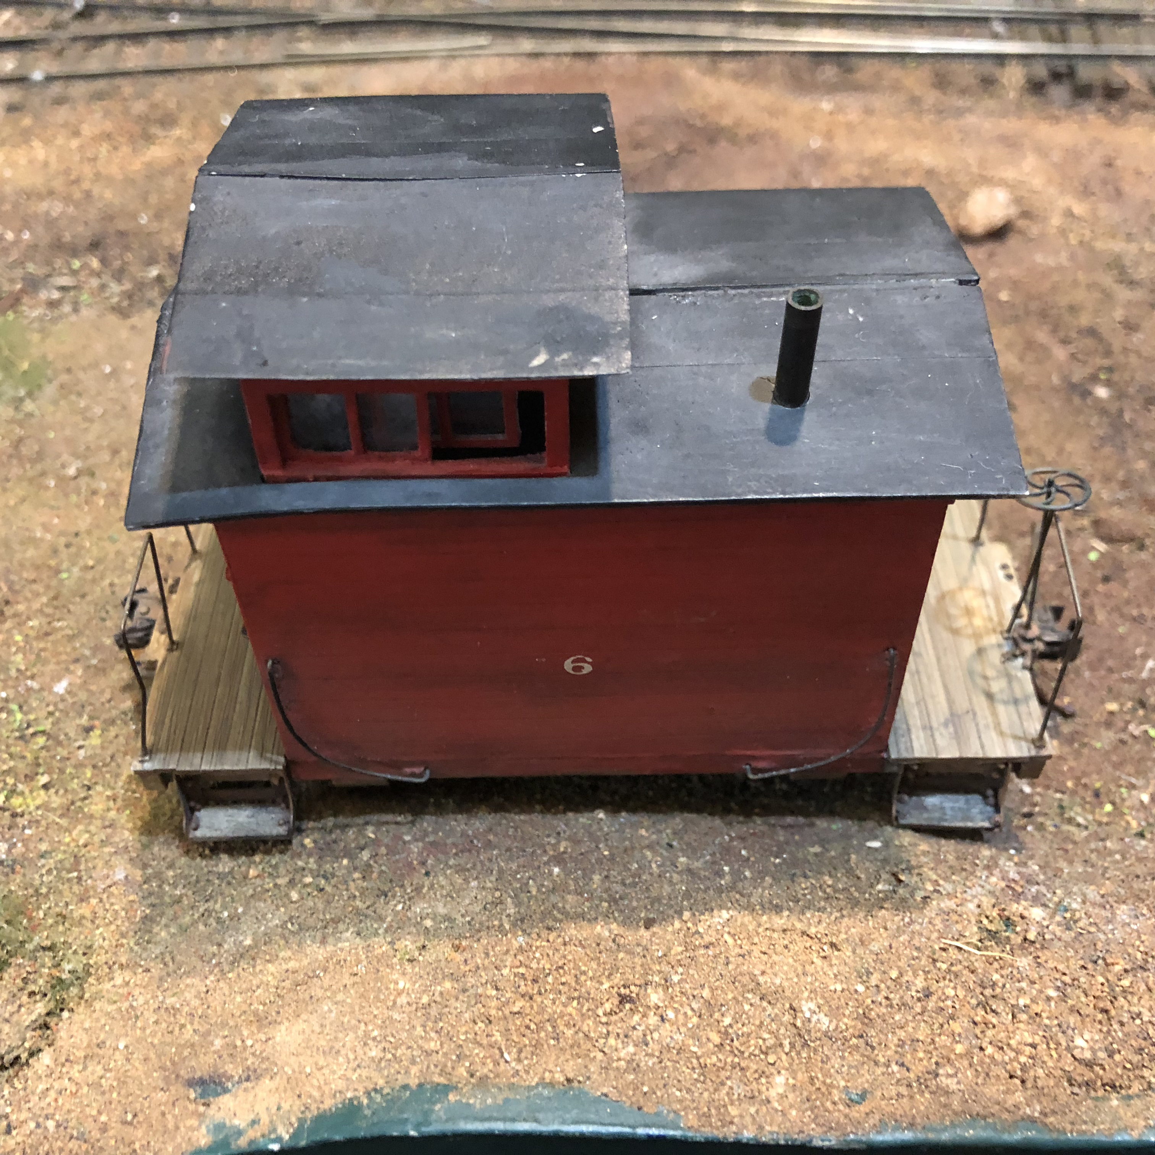
Another On3

Slide 34
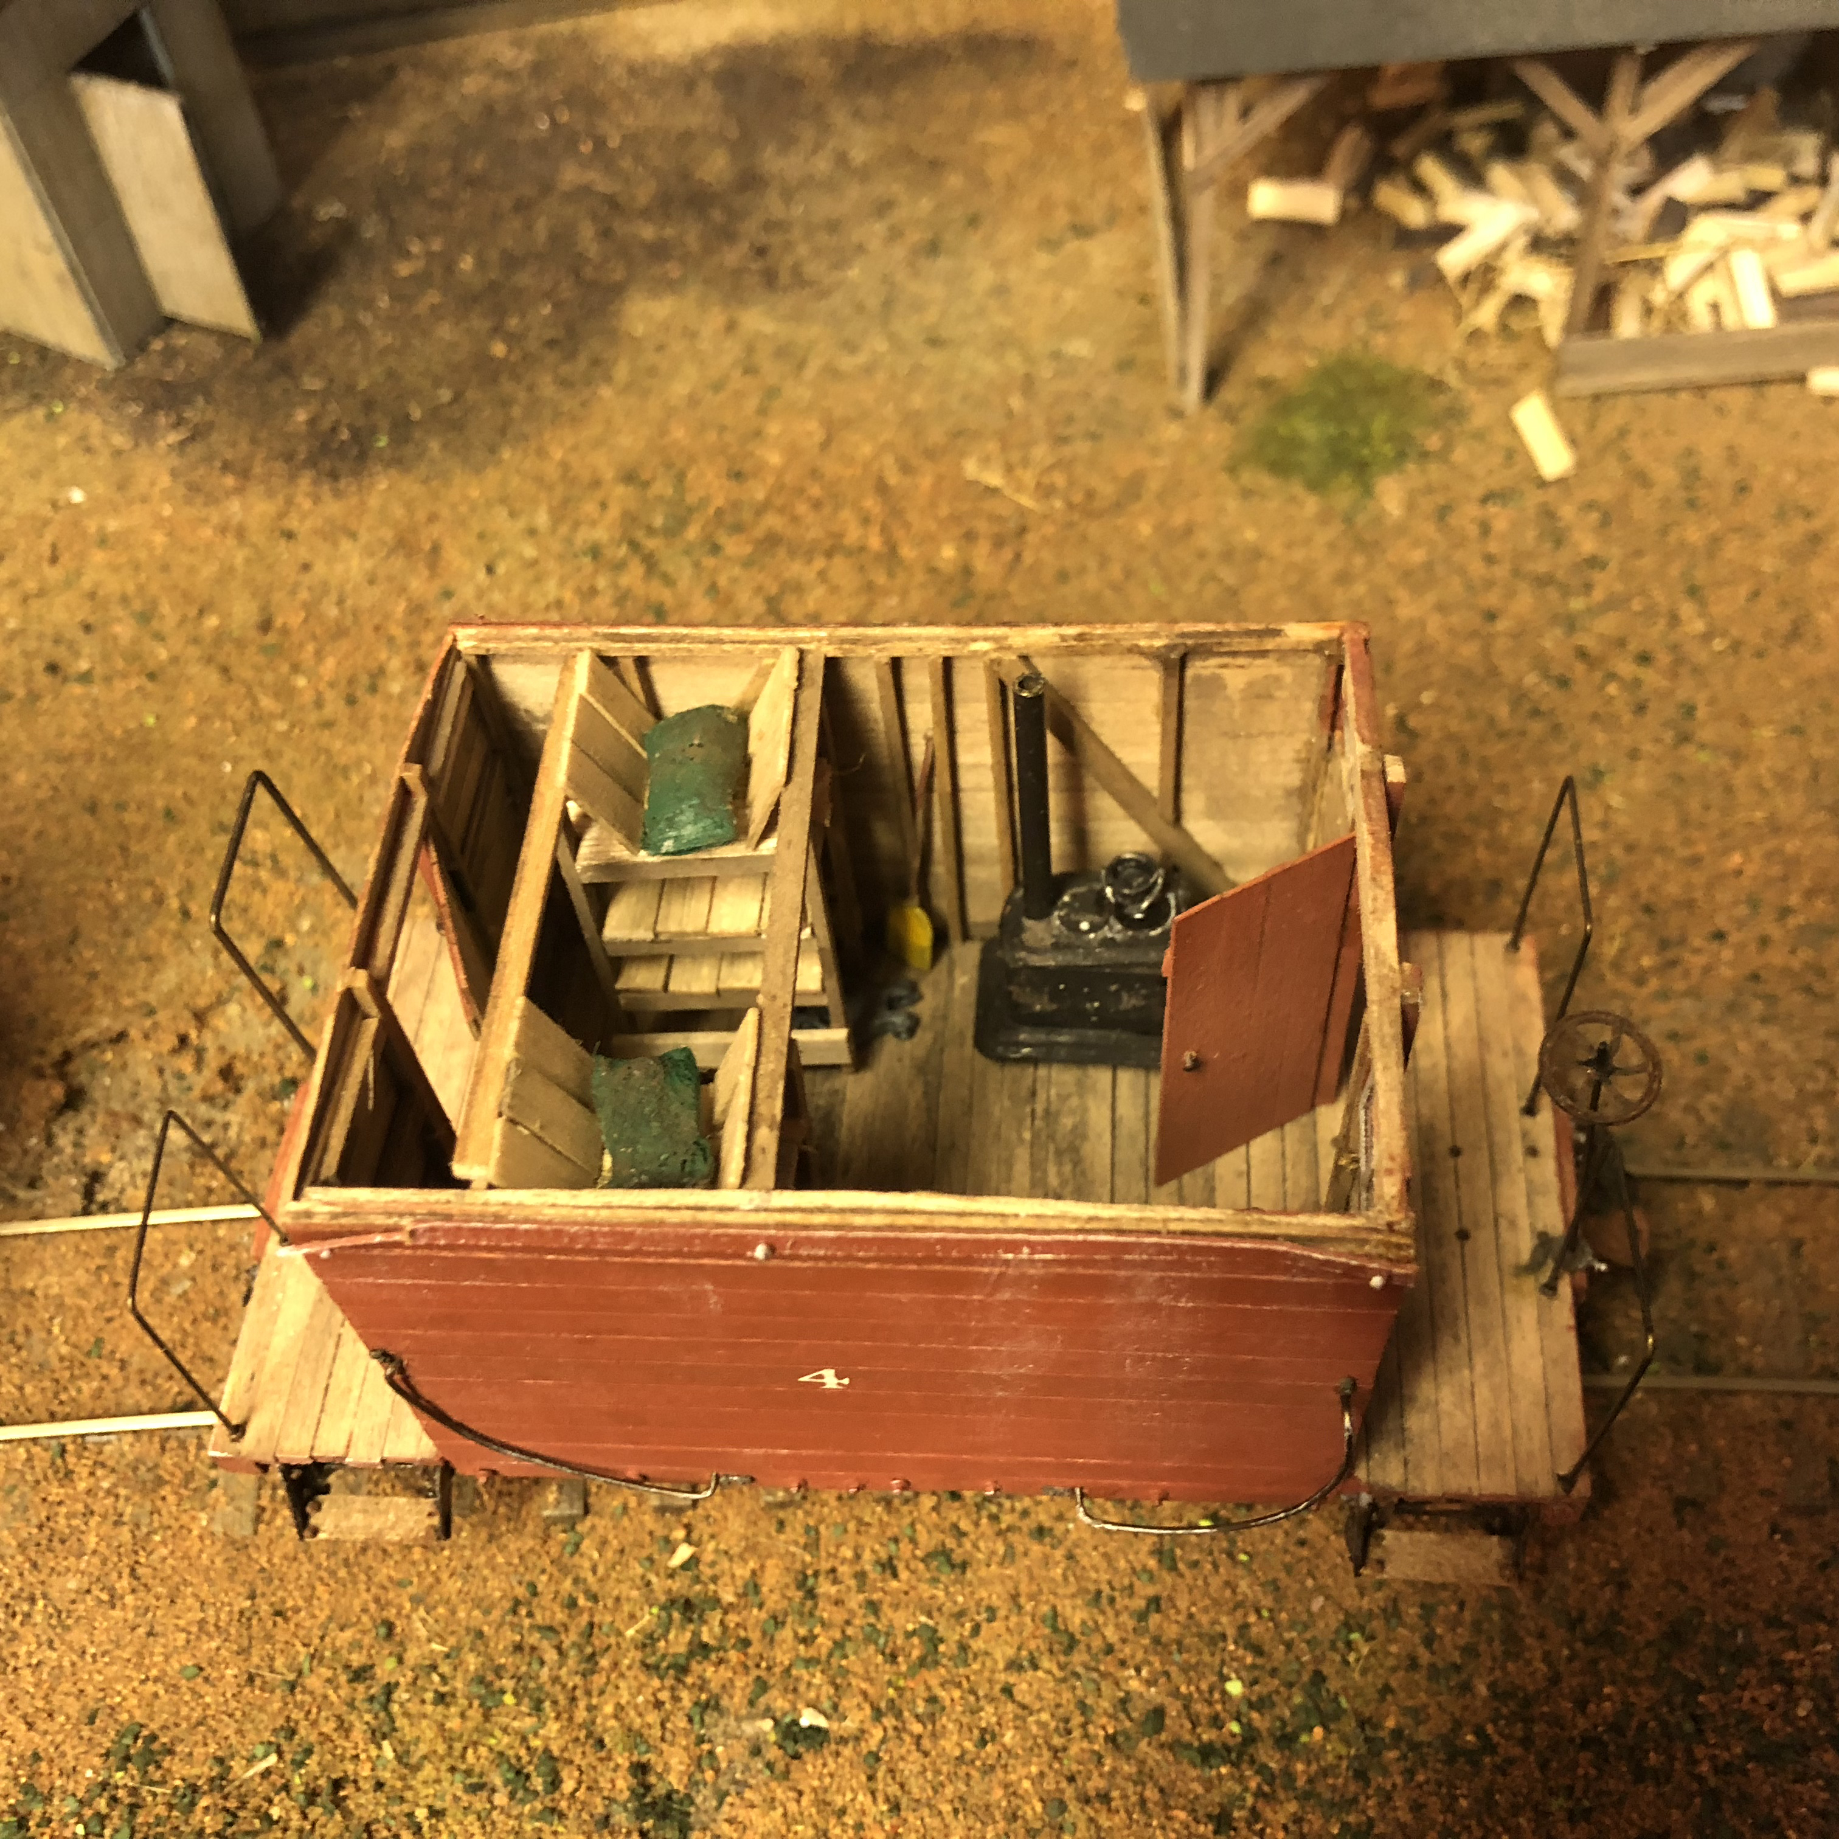
100% Scratch-Built #4 in On3 Full Interior

Slide 35
Plans
Plans for most of West Side rolling stock can be from Simpson plan sets
Also kits by such mfg. as Foothill Models.

Slide 37
Non Revenue Cars - Snowplows
Scratch-built snowplow – used Simpson
Plans of West Side Snowplos

Slide 39
Powder House Snowplow – Scratch Built from Simpson Plans and my own drawings

Slide 40
West Side Tank car.

Slide 41
Trestle – Similar to West side but not from WS plans.

Slide 42
A West Side proto flat car with a Donkey Engine

Slide 43
West Side Wooden Water Car

Slide 46
Locomotives
West side had just under 20 locomotives over the years.
2 0-4-0’s un-numbered
4 Heislers – 2 truck.
8 Shays - #5 and #6 were 2 truck, #7, #8, #9, #10, #12, #14 and #15 were all 3 truck shays. I have models of most of these.
Main engines in the woods were Shays.
In the yard area mainly Heislers. One standard gauge.

Slide 47
So for Rolling stock and engines you can see:
Used West Side Plans overall.
Modified some of them and added to them.
Could use plans and prototype as a starting point. Then added to the plans or modified.
I am going to add in a Sawmill – working on it for some time. But can not do the West Side Sawmill as even in HO scale it would take up more room than my layout room. I have:
Built all the machinery
Base is complete
Started the framework.

Slide 48
My layout specifications
Have just over 1 scale mile of mainline – West Side had 70 plus miles.
A yard, a log loading area etc.
Structures are similar to WS but not modeled exactly. All weathered and some with peeling paint.
Tightest radius is 36” – but on the prototype some turns as small as 72 feet (scaled down to 18 inches). This is one advantage to modeling a logging line.

Slide 49
Three bridges.

Slide 50
Track plan on following page
Names taken from the West Side area.
Lyon’s was actually on the Pickering Line
Mi-Wuk is a town but it is the name of the Indian tribe in that area. West Side Mill area is now owned by the tribe and there is a casino a ½ mile or so from West Side. The Mi-Wuk tribe has built a concert area on the property.
Twain Harte is where our cabin is location (also where our wedding reception was held – Epperson House).
Sonora Pass is east of Twain Harte.
Sugar Pine is a small town in the area and named after the tree.

Slide 59
So you can do the same
Pick out what you really want to do with your layout.
Find a prototype that comes close – maybe not exact.
By doing this you have a basic idea and can expound upon it and vary it to be exactly what you want.
You could even combine a few features of a couple or more prototypes.

Slide 60
References
^ Ferrell, Mallory Hope, West Side: Narrow Gauge in the Sierra, pp. 1-32, 293-312, Pacific Fast Mail, 1979.
^ "West Side Lumber Company," Tuolumne City Memorial Museum Web site (http://tuolumnecity.wordpress.com/4-museum-exhibits/westside-lumber-company/), Retrieved 9-22-2011.
^ Jump up to: ª ^{b} "The West Side Lumber Company". Pacific Narrow Gauge.
^ Cook, Walt (19 January 2010). "Taco Bell founder remembered". The Union Democrat.
^ Rowland, Marijke (3 September 2015). "Strawberry Music Festival returns to Tuolumne". Modesto Bee.
^ [1]
^ Kauppi, Art, “Annual Field Trip Will Travel to Site of West Side’s Camp 44, Active in 1940’s,” Tuolumne City Memorial Museum Newsletter, pp. 1-2, Summer, 2011, Tuolumne, CA.
Krieg, Allan (1962). The Last of the 3 Foot Loggers. Golden West.

Slide 61
So I took inspiration from West Side Lumber
Any Questions?
This will be posted on my website: www.frankmarkovich.com
Email me: frank@frankmarkovich.com

